Slide 1
Famine Fighters
By Eli Edwards, Kylun Robbins, Chandler Mendoza

Slide 2
Story
Use the team of Famine Fighters who are deemed the city’s heroes to return everybody’s food which was taken by the evil food thief.

Slide 3



Heroes
Players will switch between three characters, each with their own special ability, to complete levels.
TMNF
Not Finn
VR Blues
(Teenage Mutant Ninja Frog)

Slide 4

Villain
Players will have to advance through the game to face the food thief:
*Name Withheld*

Slide 5

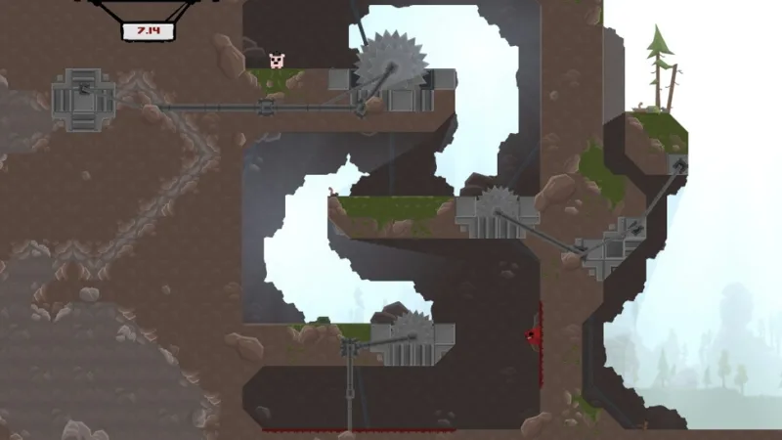
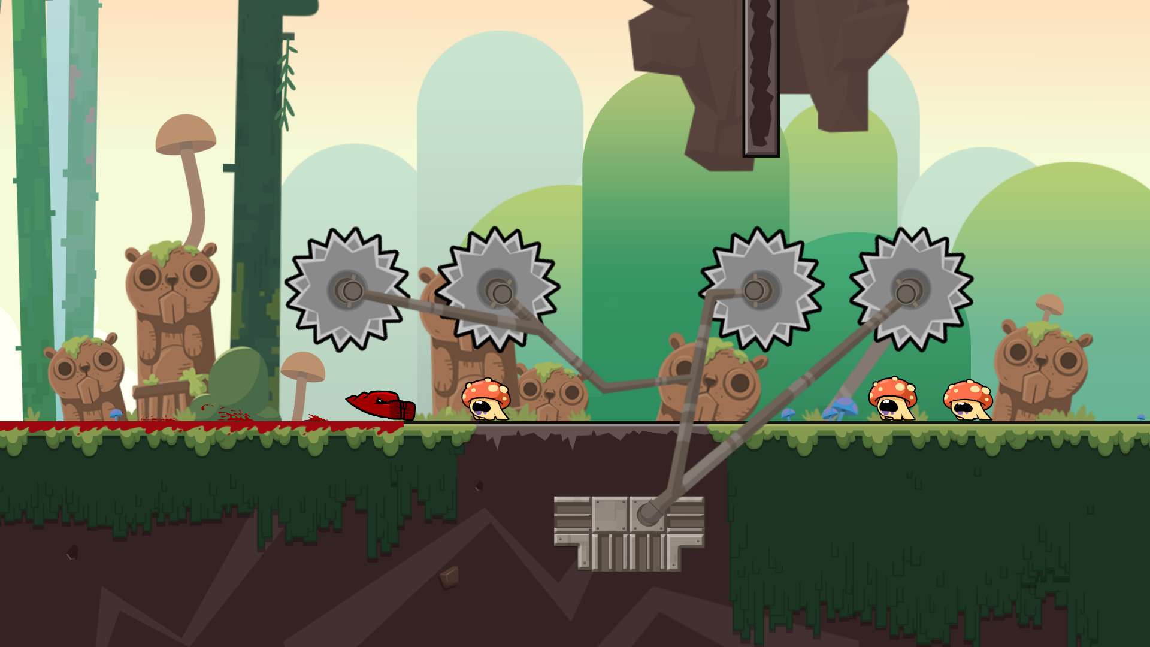
Super Meat Boy
Various Traps
Difficult Movement
Slide Down Walls
Simple Story (Rescue Girlfriend)
One main villain

Slide 6
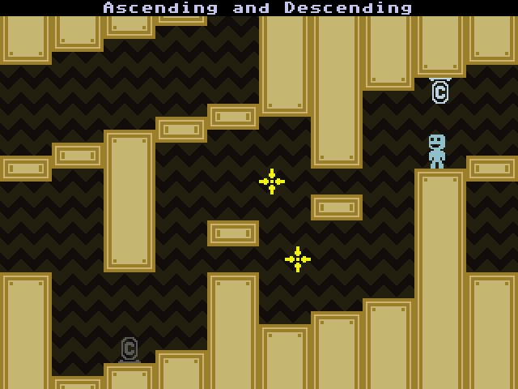

VVVVVV
2D
Puzzle Platformer
Gravity Flip

Slide 7



Gameplay
Traverse through levels that get progressively more difficult
Use movement features and problem solving to avoid various traps
Win Condition: Reach end of level with required items (if needed)
Lost Condition: If you die during the level you respawn at the beginning
Final Win Condition: Reach the end and return the food
Upgrades: Collect power-ups to increase your health (how many mistakes you can make)
Achievements: Time based each level will have target times for gold, silver, and bronze

Slide 8
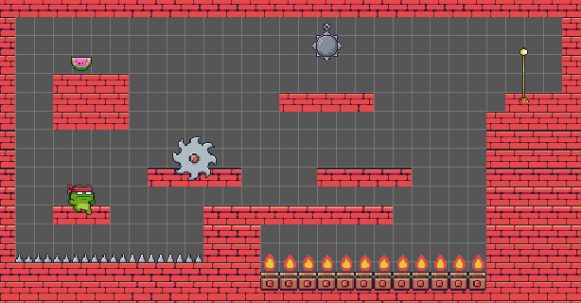
Sample Level

Slide 9
Prototype
Double Jump
Slide Down Wall
Change of Gravity
Item to Unlock Door
Power Ups to Increase Health (adds glowing effect to hero)
Switchable characters

Slide 10
Wishlist
Level Menu
Ability to retry already completed levels for better time
Different material blocks
Sand, ice, slime, etc. each with unique mechanics
Kelvin Mode
Unlimited health
Ability to fly
Extra level of medal (diamond) for beating best developer time

Slide 11
Schedule
Week 1: Player Movement & Prototypes
Week 2: Puzzle, Enemies, One Level & Demo
Week 3 & 4: Finish 3 Levels & Alpha
Week 5: Add Multiple Levels, Improve Based on Feedback & Beta
Week 6 & 7: Fine Tune & Final Release

Slide 12
Questions?

